Slide 1
Lecture 5: Line Detection and Hough Transform
January 29, 2020

Slide 2
Grouping and Fitting
In many applications we need to fit a number of data points into a certain model, for example:
Edge detection produces number of points that belongs to edges
We do not have a sense of what line consists of which points
Even if we have only one line, the noise in the image produces noisy edge points
Lines can be broken due to illumination effects

Slide 3
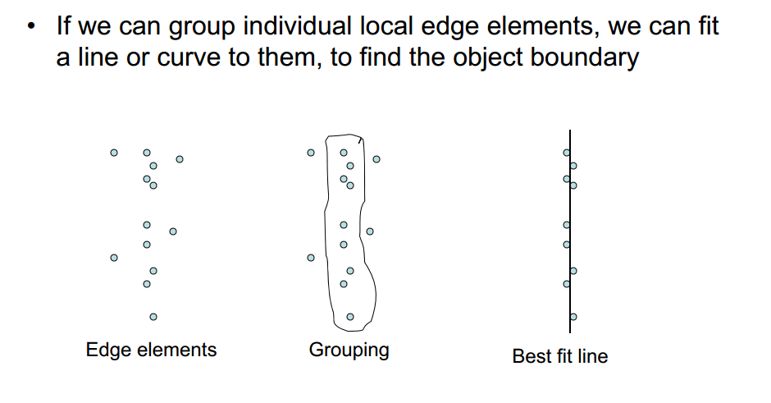

Slide 4
How to Fit A Line?
Global optimization
Least squares Fit (over constraint)
Number of points exceed the number of parameters (slope and intercept in lines)
Robust least squares
Iterative closest point (ICP)
Hypothesize and test
RANSAC (constraint)
Use only exact number of points to find the required parameters and see how many outliers vs. how many inliers
Hough Transform (under constraint)
Take one point at a time and generate all possible solutions – the solution with the maximum number of votes becomes the best fit

Slide 5
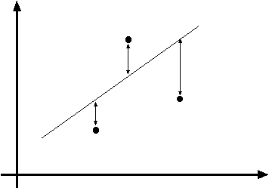
Least Squares Fit
Standard linear solution to estimating unknowns.
If we know which points belong to which line
Or if there is only one line
y = mx + c = f (x, m, c)
[y − f (x , m, c)]
2
[y − f (x , m, c)]
Minimize E =
∑
2

Slide 6
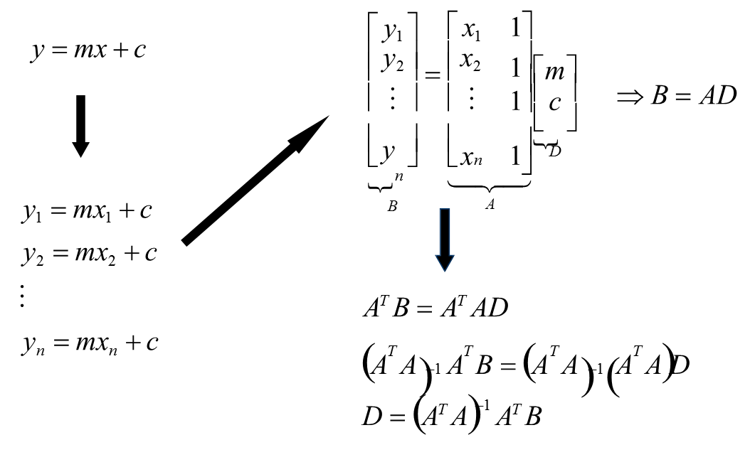
Line Fitting

Slide 7
Hough Transform
METHOD AND MEANS FOR RECOGNIZING COMPLEX PATTERNS, Paul V. C. Hough et al
Inventors: Paul V. C. Hough
Current U.S. Classification: 382/281; 342/176; 342/190; 382/202
http://www.google.com/patents?vid=3069654

Slide 8
Introduction
It is a global processing technique
Developed by Paul Hough in 1962 and patented by IBM
Useful for detecting any parametric curves
Relatively robust to gaps in lines and noise

Slide 9
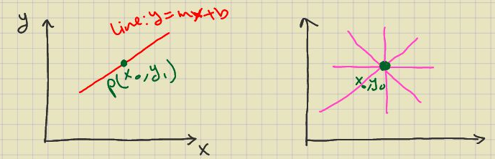
Points in the spatial domain
A line in the x-y plane will have an equation:
y=mx+b (thus it has two parameters)
Given a point (x₀,y₀), the lines that can pass through it are unlimited, but they must all satisfy:
y₀=mx₀+b or in other words b=-x₀ m + y₀

Slide 10
The point (x₀,y₀) represents an equation in the (m,b) parameters space
If two point are on the same line in the (x,y) space then their lines intersect in (m,b) parameter space

Slide 11
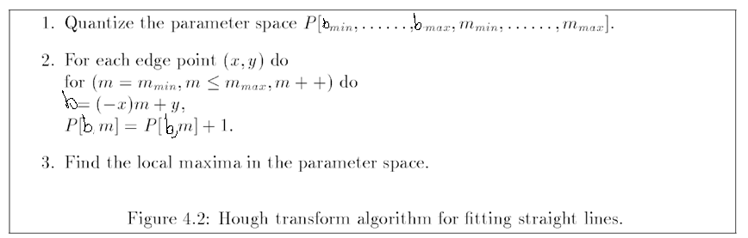
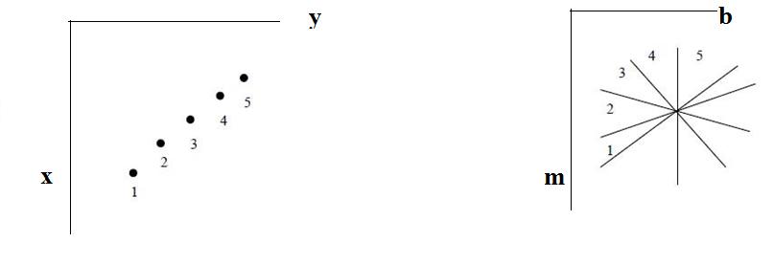

Algorithm to Fit Straight Lines
m_{min}
m_{max}
b_{min}
m
5
b_{max}
b = (− x_{i} )m
+ y_{i}
b

Slide 12
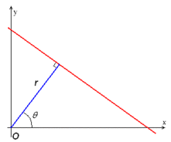
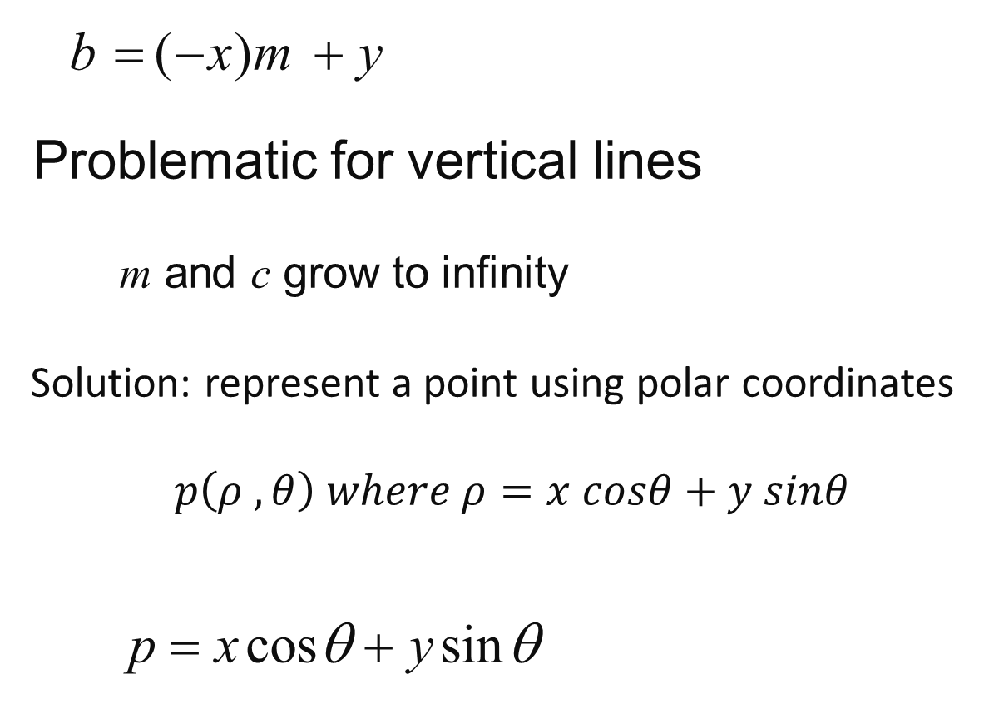
Polar Form of Equation of Line
b = (− x)m + y
Problematic for vertical lines
m and c grow to infinity
Solution: represent a point using polar coordinates
$$p\left(ρ , θ\right) where ρ=x cosθ+y sinθ$$
p = x cosθ + y sinθ

Slide 13
A point is now represented with a sinusoidal curve in the parameter space
Angle range is -90…+89
Rho range is –D_{max}… D_{max} (D_{max} is the largest possible distance)

Slide 14
Matlab Example
I=zeros(101,101);
I(1,1)=1;
I(1,101)=1;
I(101,1)=1;
I(51,51)=1;
I(101,101)=1;
figure, imshow(I);
[H,theta,rho] = hough(I);
figure, imshow(imadjust(mat2gray(H)),'XData',theta,'YData',rho,...
'InitialMagnification','fit');
title('Hough Transform');
xlabel('\theta'), ylabel('\rho');
axis on, axis normal, hold on;

Slide 15
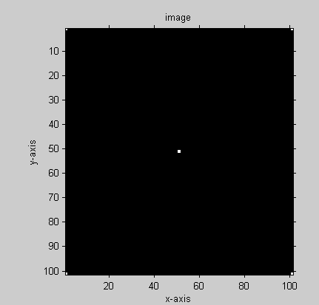
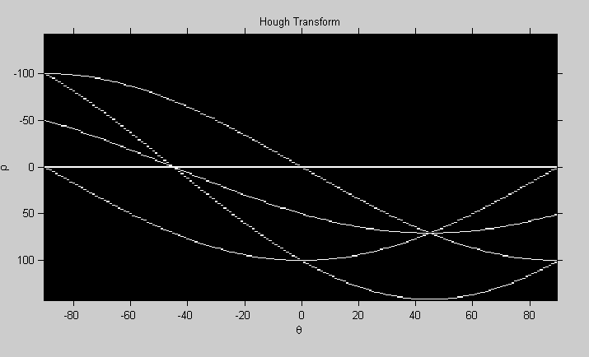
Rho changes from – D to D which
is the diagonal of the image
Theta changes from -90 to 90
-144
5 curves corresponding to 5 points in above figure.
144

Slide 16
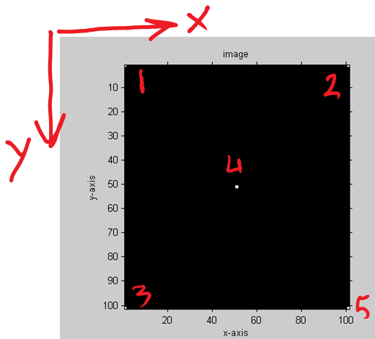
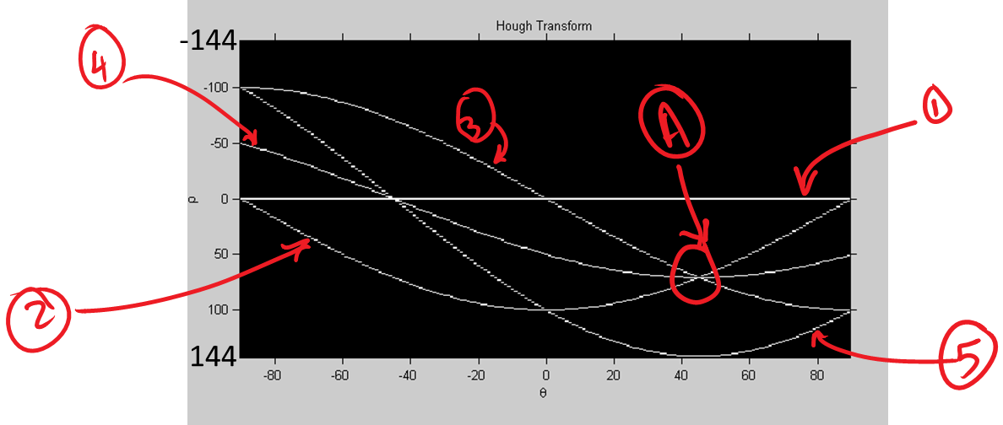
The point A in the parameter space indicates that the points 2,3, 4 in the image plane are on the same line that has an angle of 45 degrees
Memorial University of Newfoundland
16

Slide 17
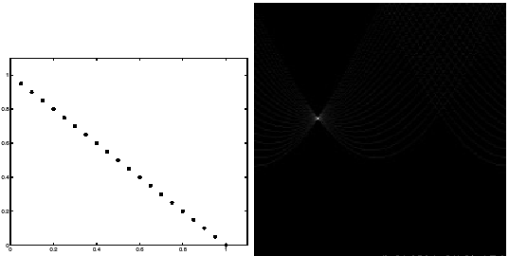
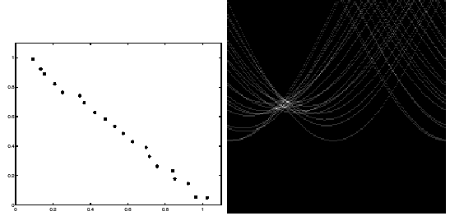
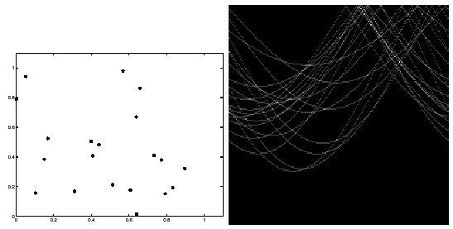
Line Fitting Examples
ideal
noisy
very noisy

Slide 18
Difficulties
What is the increments for θ and p.
too large? We cannot distinguish between different lines
too small? noise causes lines to be missed

Slide 19
Edge-linking Based on the Hough Transform
Obtain a binary edge image
Specify subdivisions in
Examine the counts of the accumulator cells for high pixel concentrations
Examine the relationship between pixels in chosen cell

Slide 20
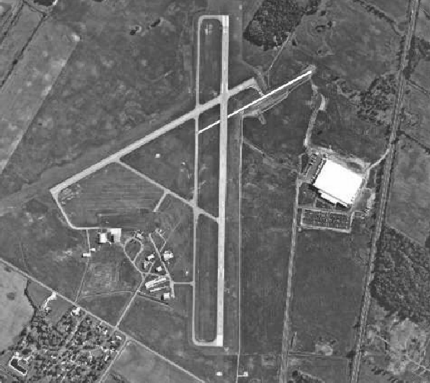

Slide 21
It is required to find the main runway
We perform the step as discussed previously
We know that the runway is almost vertical so we select the cells corresponding to ±90
We look for the highest counts in the cells at ±90 because we know the main runway is the lonest lines in the image
We only needed to know the
orientation of the runway and
the observer position

Slide 22
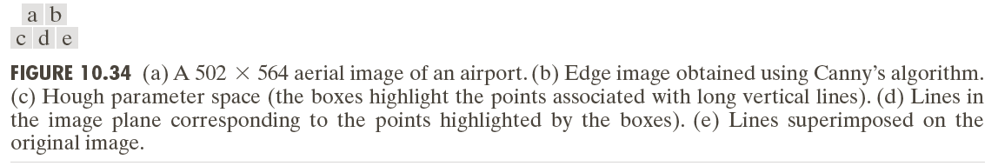

Slide 23
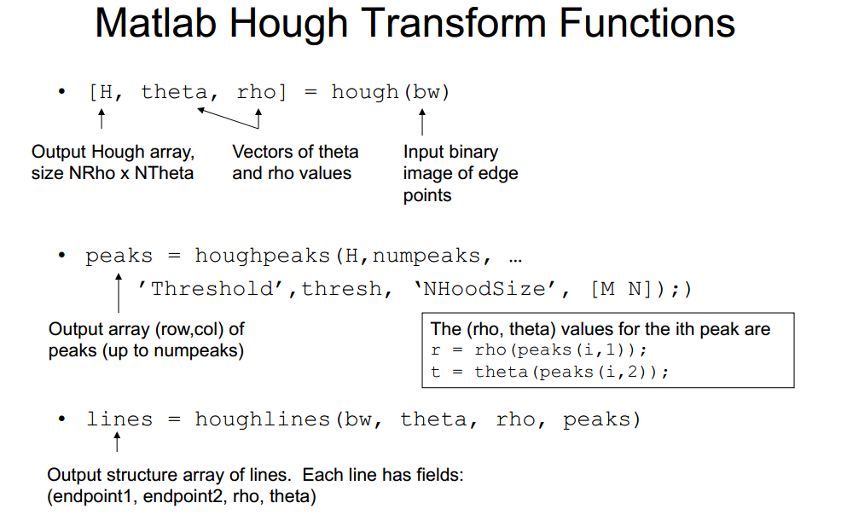

Slide 24
I = imread('gantrycrane.png');
G = rgb2gray(I);
E = edge(G, 'canny');
imshow(E);
[H,theta,rho] = hough(E);
figure, imshow(H,[]);
peaks = houghpeaks(H,50,'Threshold',30);
figure, imshow(G,[]), hold on
lines = houghlines(E,theta,rho,peaks,'FillGap',5,'MinLength',15);
for k = 1:length(lines)
xy = [lines(k).point1;
lines(k).point2];
line(xy(:,1),xy(:,2),'LineWidth',1,'Color','r');
end

Slide 25
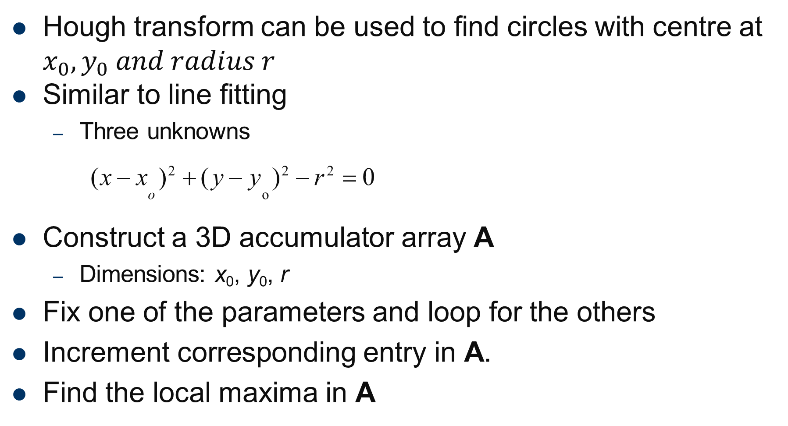
Circle Fitting
Hough transform can be used to find circles with centre at $x_{0},y_{0} and radius r$
Similar to line fitting
Three unknowns
(x − x )² + ( y − y )² − r ² = 0
o o
Construct a 3D accumulator array A
Dimensions: x₀, y₀, r
Fix one of the parameters and loop for the others
Increment corresponding entry in A.
Find the local maxima in A

Slide 26
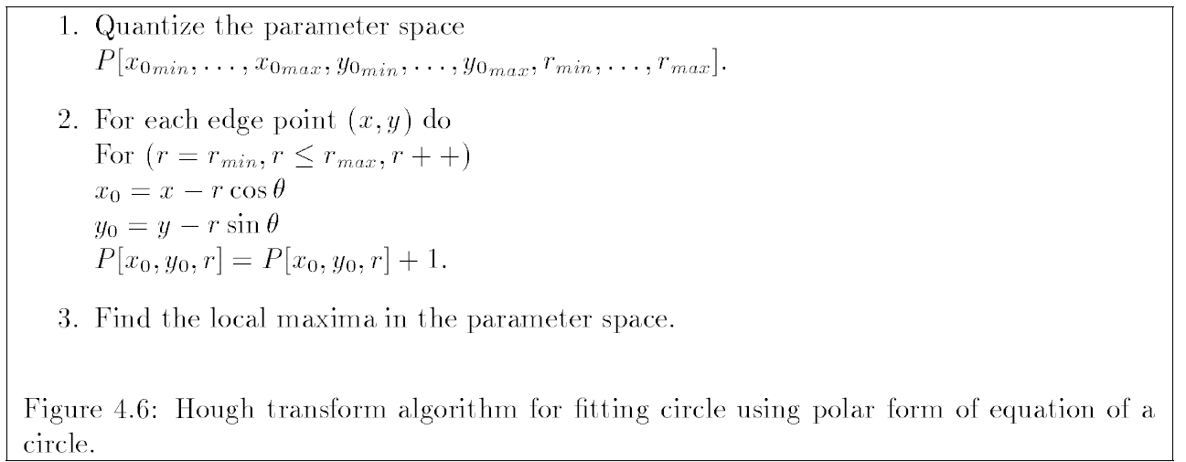
Accumulator grid is now 3D

Slide 27
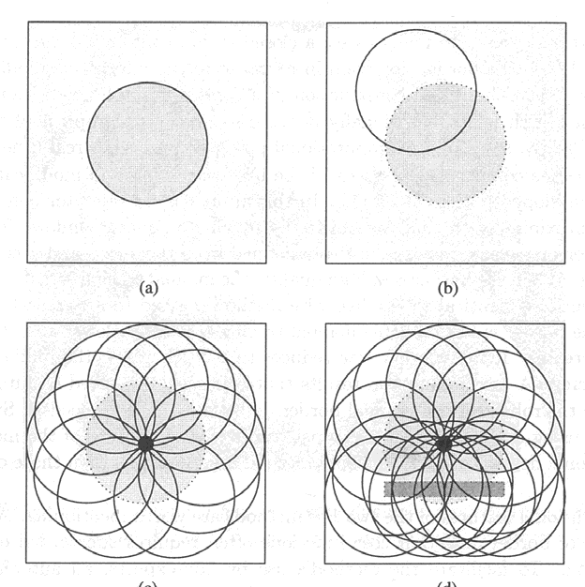
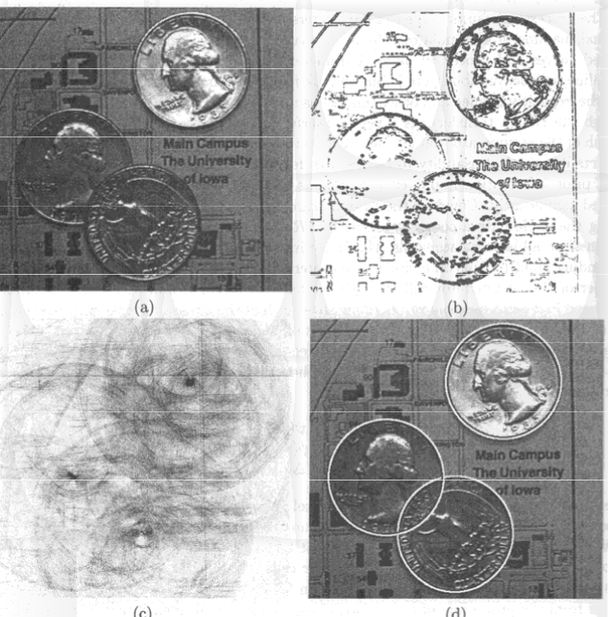
Examples

Slide 28
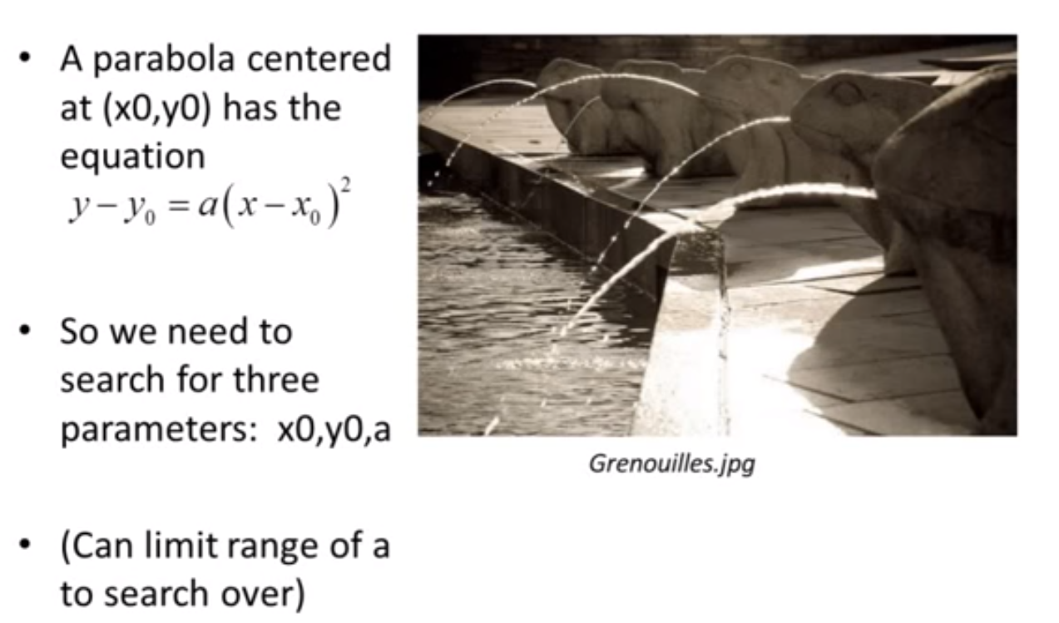
Parabolas Fitting

Slide 29
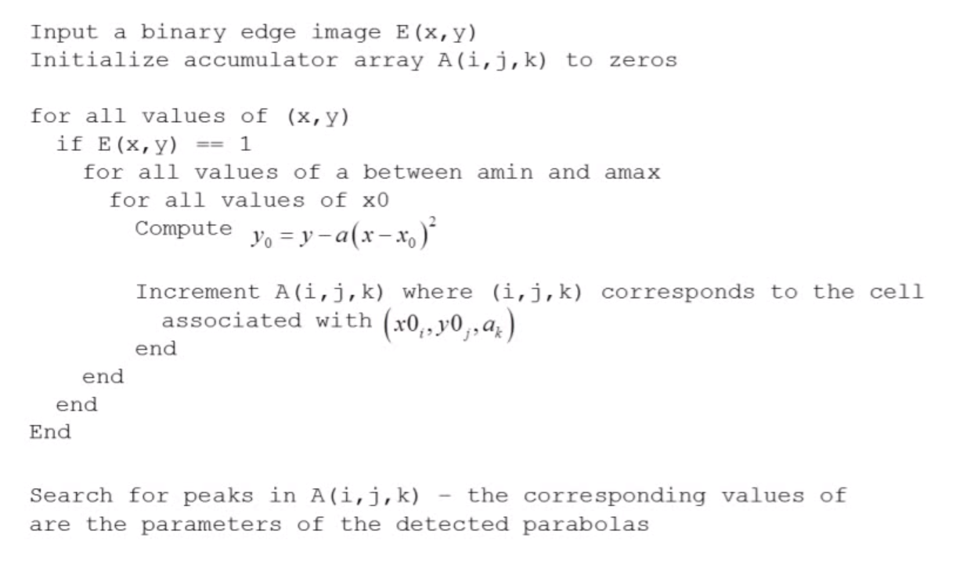
Pseudo Code

Slide 30
% Find parabolas in binary image I(N,M).
% A parabola is y=rx^2
clear all;
close all;
I = rgb2gray(imread('Grenouilles.jpg'));
imshow(I,[]);
[N,M] = size(I);
[E,thresh] = edge(I, 'canny', 0.45);
figure, imshow(E,[]);
rvals = [ 0.003, 0.004, 0.005, 0.006, 0.007, 0.008 ];
R = length(rvals); % number of sizes to try
% Fill accumulator array A(N,M,R)
A = zeros(N,M,R);
[yIndex, xIndex] = find(E); % get edge points
for cnt = 1:length(xIndex)
for r=1:R
for x0 = 1:M
y0 = yIndex(cnt)-rvals(r)*(xIndex(cnt)-x0)^2;
y0 = round(y0);
if y0 < N & y0 >= 1
A(y0,x0,r) = A(y0,x0,r)+1;
end
end
end
end
figure, imshow(A(:,:,round(R/2)),[]);
title(sprintf('A slice of the accumulator array, for r=%f', rvals(round(R/2)) ));
pause;

Slide 31
% Find the local maxima in a 3D neighborhood
Amax = imdilate(A, ones(20,20,4));
% We want those places where A = AMax and A > thresh
thresh = 95;
Apeaks = (A==Amax) & (A > thresh);
% Get indices of the peaks (the nonzero points).
% These are the indices of the array, which is treated
% like a one dimensional array.
indices1D = find(Apeaks);
% The array is actually three dimensional, not one dimensional.
% This function will calculate the equivalent indices of the three
% dimensional array.
[rowIndices,colIndices,depthIndices] = ind2sub(size(Apeaks), indices1D);
figure, imshow(E,[]);
for i=1:length(rowIndices)
x0 = colIndices(i);
y0 = rowIndices(i);
r0 = rvals( depthIndices(i) );
for x=1:M
y = round(y0 + r0*(x-x0)^2);
if y<=N && y >= 1
rectangle('Position', [x y 1 1], 'EdgeColor', 'r');
end
end
end

Slide 32
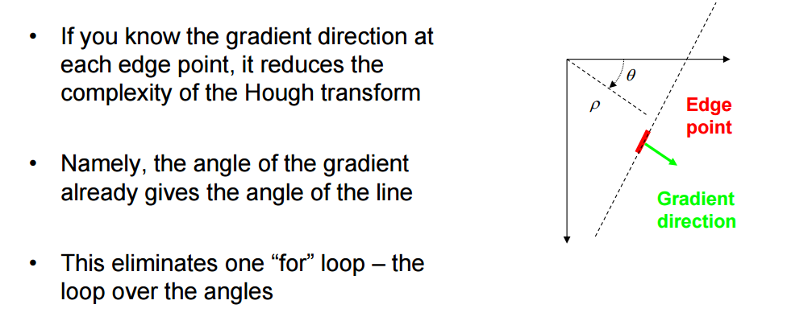
Extension to Use Gradient Direction

Slide 33
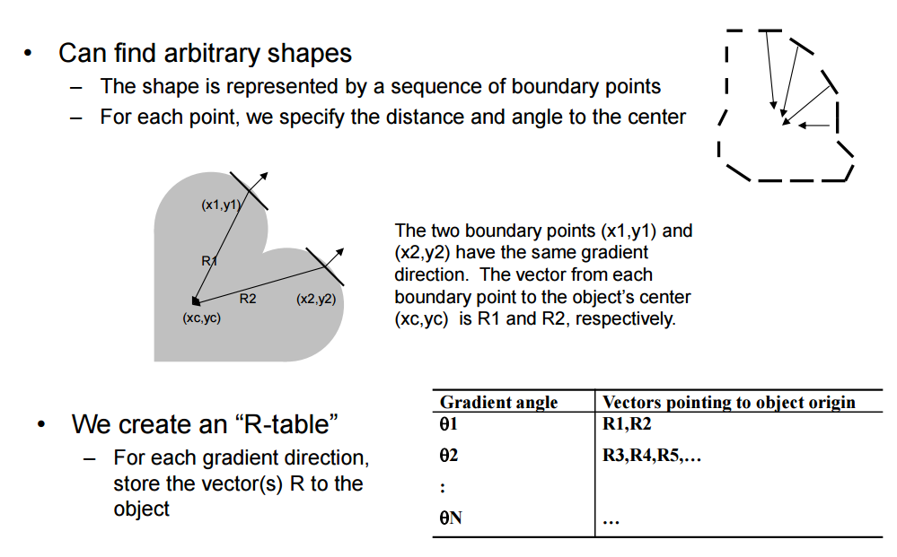
Generalized Hough Transform

Slide 34
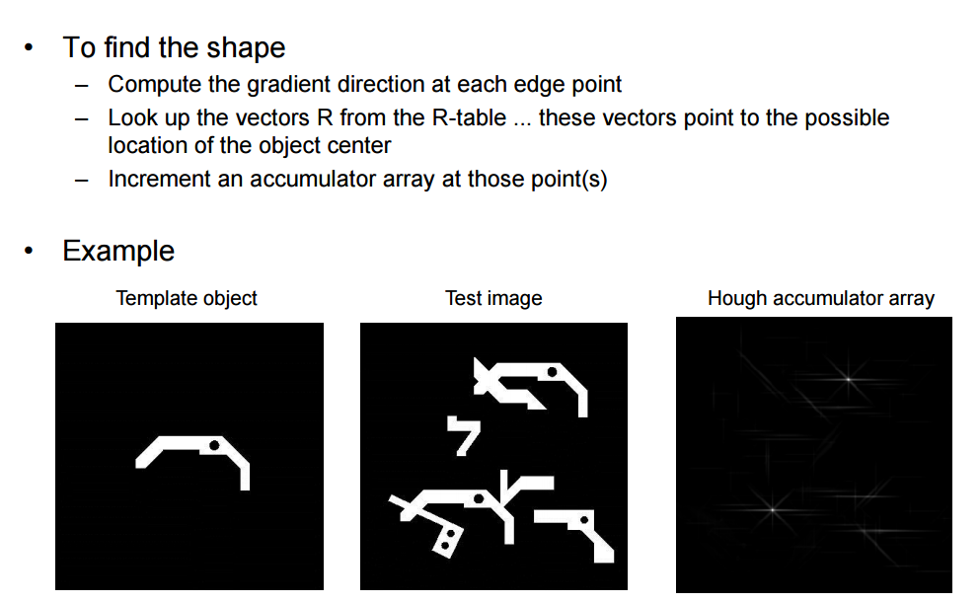

Slide 35
Ellipse and Line Segment Detection (ELSD)
Objective: automatic detection of basic geometric features such as line segments and elliptical arcs.
Automatic geometric feature detectors are based on either
Hough based
Edge chaining

Slide 36
Edge Chaining Algorithms
Start from a seed pixel or group of pixels
Use geometric properties
Straightness (fora line segments)
Curvatures (for elliptical arcs)
A line or ellipse is fitted to the gathered pixels.
Memorial University of Newfoundland
36

Slide 37
ELSD Algorithm
Candidate selection
feature candidates are identified using a heuristic
Validation
Each candidate has to pass a validation phase
Model selection

Slide 38
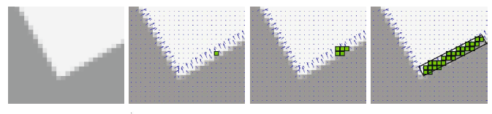
Candidate Selection
Region growing
Conventional feature detectors operate on edge maps.
Start from a seed pixel and grow to the region based on gradient orientation of pixels.

Slide 39
Candidate Selection
Curve growing
Conventional feature detectors operate on edge maps.
Combine neighbor regions produce by region growing using convexity and smoothness rules
The convexity rule imposes that consecutive pairs of rectangles turn in the same direction; thus Δθi and Δθi+1 have the same sign.
The smoothness rule is roughly imposed by chaining only regions whose orientations differ by less than π/2.

Slide 40
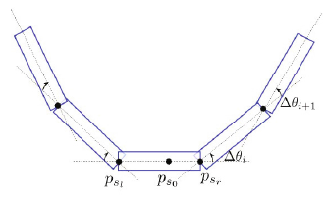
Candidate Selection
Result of curve growing
Memorial University of Newfoundland
40

Slide 41
Candidate Selection
Curve fitting
pixels gathered in steps A and B respectively, are used to estimate the line segment and the elliptical hypotheses
region => rectangle fit => line segment hypothesis;
curve => circular/elliptical ring fit => circle/ellipse hypothesis.

Slide 42
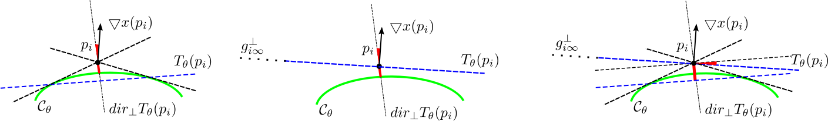
Candidate Selection
The tangent to the conic in a point pi is also the polar of the point pi w.r.t. the conic.
The algebraic distance error and the gradient orientation error can be simultaneously minimized through a non-iterative procedure. This improves the accuracy, especially when pixels are sampled along incomplete circles/ellipses.

Slide 43
Validation
Automatically reject candidates whose presence might be accidental.
The ‘a contrario’ theory uses the non-accidentalness principle; informally, it says that "we see nothing in noise". Thus, hypotheses that are likely to be observed in noise should be automatically discarded. To this end we need to define two elements: a model of "noise" (unstructured data) and a function to measure the quality (degree of structured-ness) of a hypothesis.

Slide 44
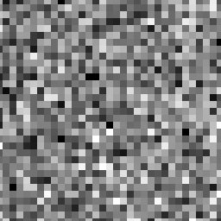
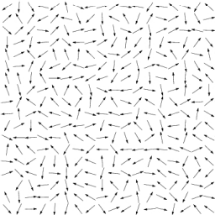
Validation
Model of unstructured data: field of gradients whose orientations can be considered i.i.d. random variables => Gaussian white noise image

Slide 45
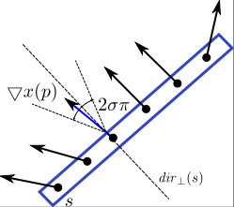
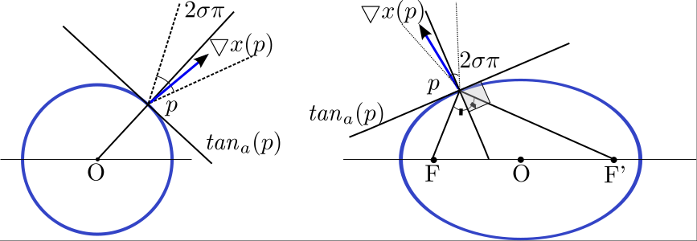
Validation
Model of unstructured data: field of gradients whose orientations can be considered i.i.d. random variables => Gaussian white noise image;

Slide 46
Validation
Validation test: accept as meaningful hypotheses only those too structured to appear by chance in unstructured data. If a hypothesis contains too many aligned points, it is not likely for it to be observed in noise; thus it is meaningful.
The Number of False Alarms (NFA) is the essential quantity used to assess the validity of a hypothesis, and is given by NFA=N⋅Β(l,k,σ), where N is number of hypotheses, l is number of pixels in hypothesis and k is number of aligned pixels in hypothesis, and Β(l,k,σ) is binomial tail = ∑ li=k C li σ i(1-σ) l-i.

Slide 47
Validation
A hypothesis is considered meaningful iif it satisfies the validation test NFA ≤ ε.
Control of false positives: If a hypothesis is accepted as meaningful only when the above validation test stands, then the number of meaningful hypotheses observed by chance in unstructured data is less than ε (see the paper for a proof of this proposition).

Slide 48
Model Selection
When more than one hypothesis passes the validation test, a model selection needs to be performed to choose the most suitable geometric interpretation for the given data. Ockham's razor principle recommends to
choose the best geometric interpretation for the data, but penalize complexity.
In ELSD uses NFA as model selection criterion [3] and keep as valid hypothesis the one with the lowest NFA.

Slide 49
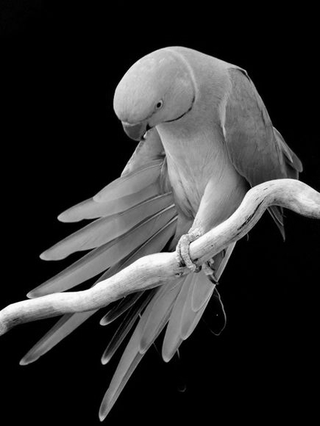
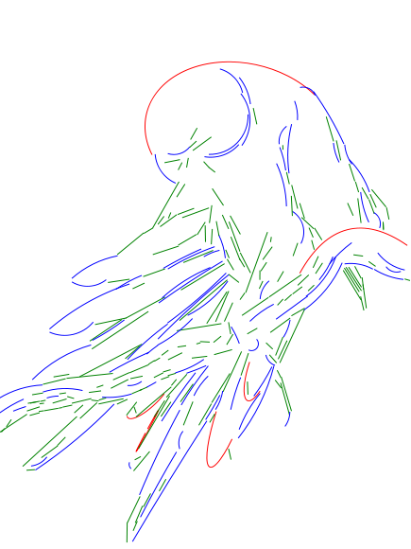
Example

Slide 50
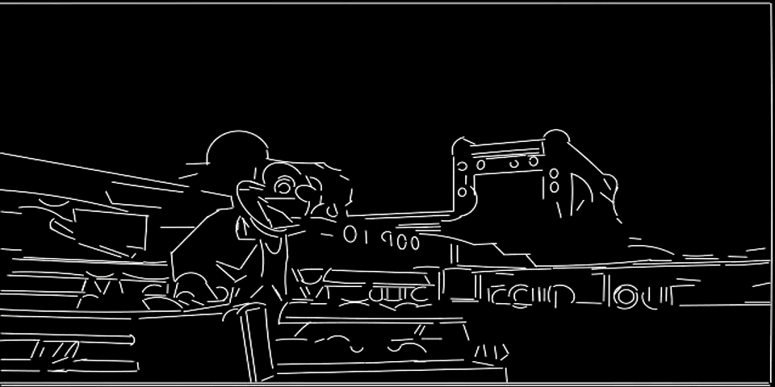
Example

